Slide 1
Effectiveness of ML Algorithms in Predicting Mental Health Issues
Aparna Raghavendra Rao

Slide 2
57,800,000
Adults (18 or older) in the USA live with a mental health disorder
Source: NIMH 2021 Statistics

Slide 3
Project Objectives
Data Collection
Machine Learning Applications
In diagnosing mental health disorders
Use a dataset to build machine learning models
Model Comparison
Data visualization
Compare the performance of ML models in diagnosing mental health disorders
Visualize data for better understanding

Slide 4
Literature Review
Paper 1
Paper 2
Paper 3
Found that decision tree was best for predicting stress, SVM for depression, Linear Regression & Neural Networks for anxiety
Found that Multilayer Perceptron, Multiclass Classifier, and the Logical Analysis of Data (LAD) Tree were most accurate in predicting mental health problems affecting children
Found that accuracy of the stacking model was the highest among Logistic Regression, K-NN Classifier, Decision Tree Classifier, Random Forest, and Stacking
Paper 4
Paper 5
Found that among supervised learning methods commonly used in mental health issues detection, SVM is the most used ML technique
SVM, KNN, Random Forest performed equally well. Using ensemble methods improved accuracy significantly

Slide 5
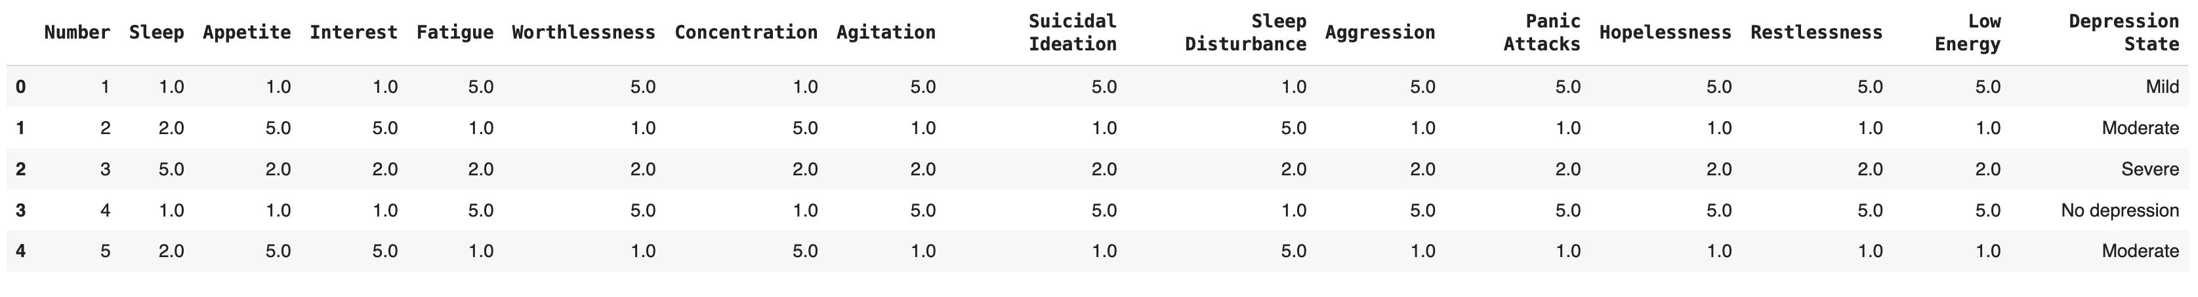
Data collection & analysis
Dataset - Mental Health Detection Dataset from kaggle.com
Dataset Description –
Number of Rows: 540
Number of Columns: 16
Screenshot of data:
Independent Variables: Numerical
Target Variable: Categorical
Unique Patient Identifier

Slide 6
Hypothesis: Supervised learning methods will be more effective than unsupervised learning methods in diagnosing mental health disorders

Slide 7
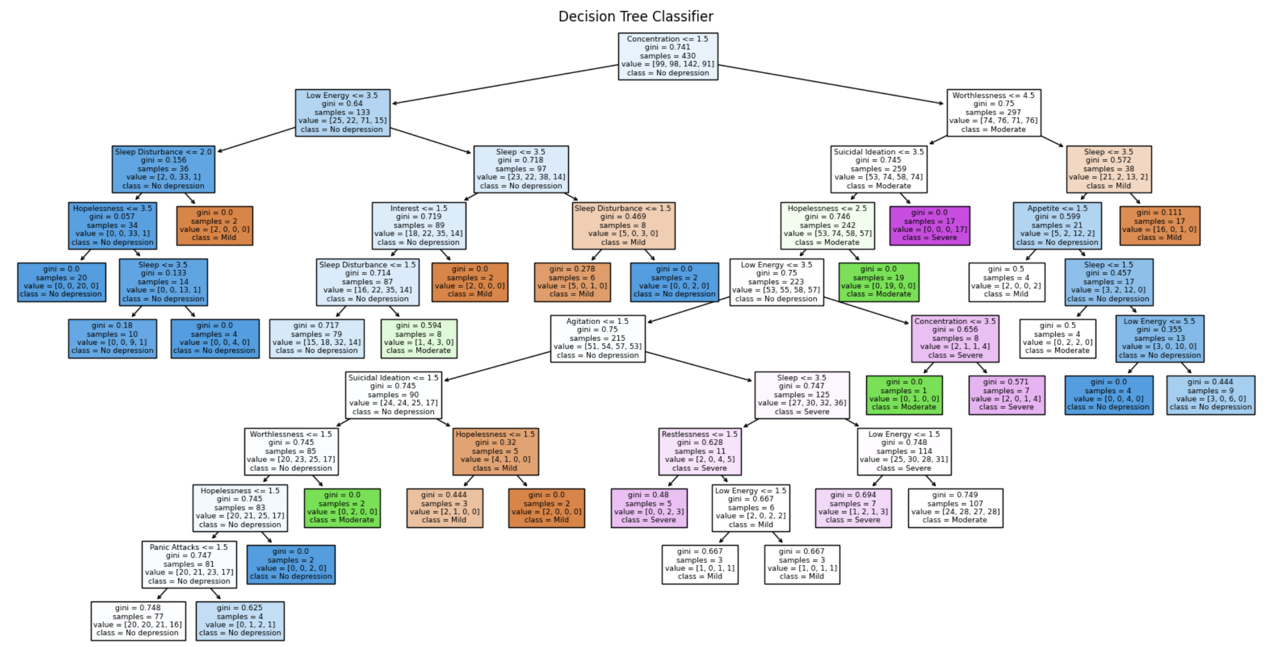
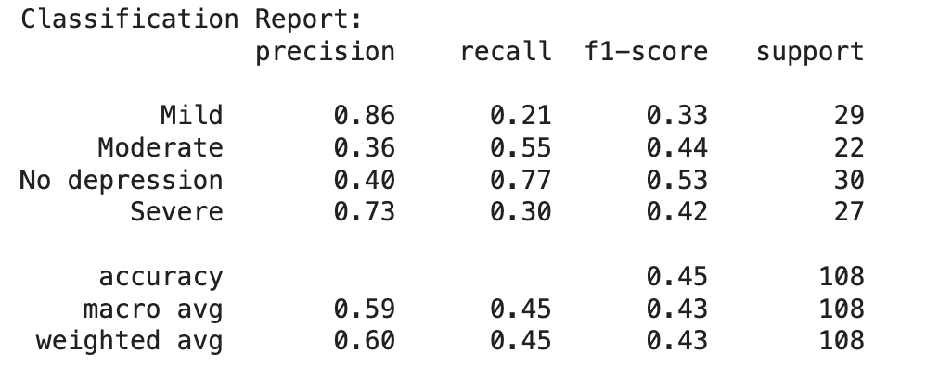
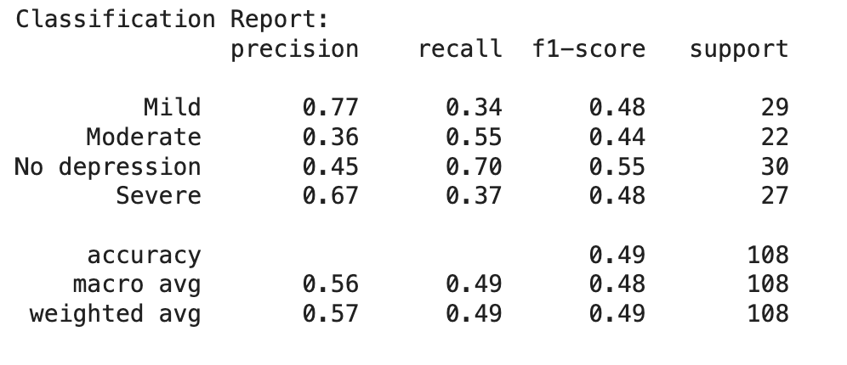
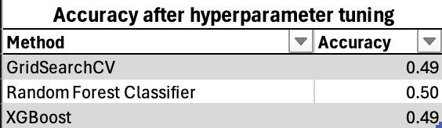
Supervised Learning Models Decision Tree vs SVM
Both supervised learning models have low accuracy scores between 45% and 50%

Slide 8
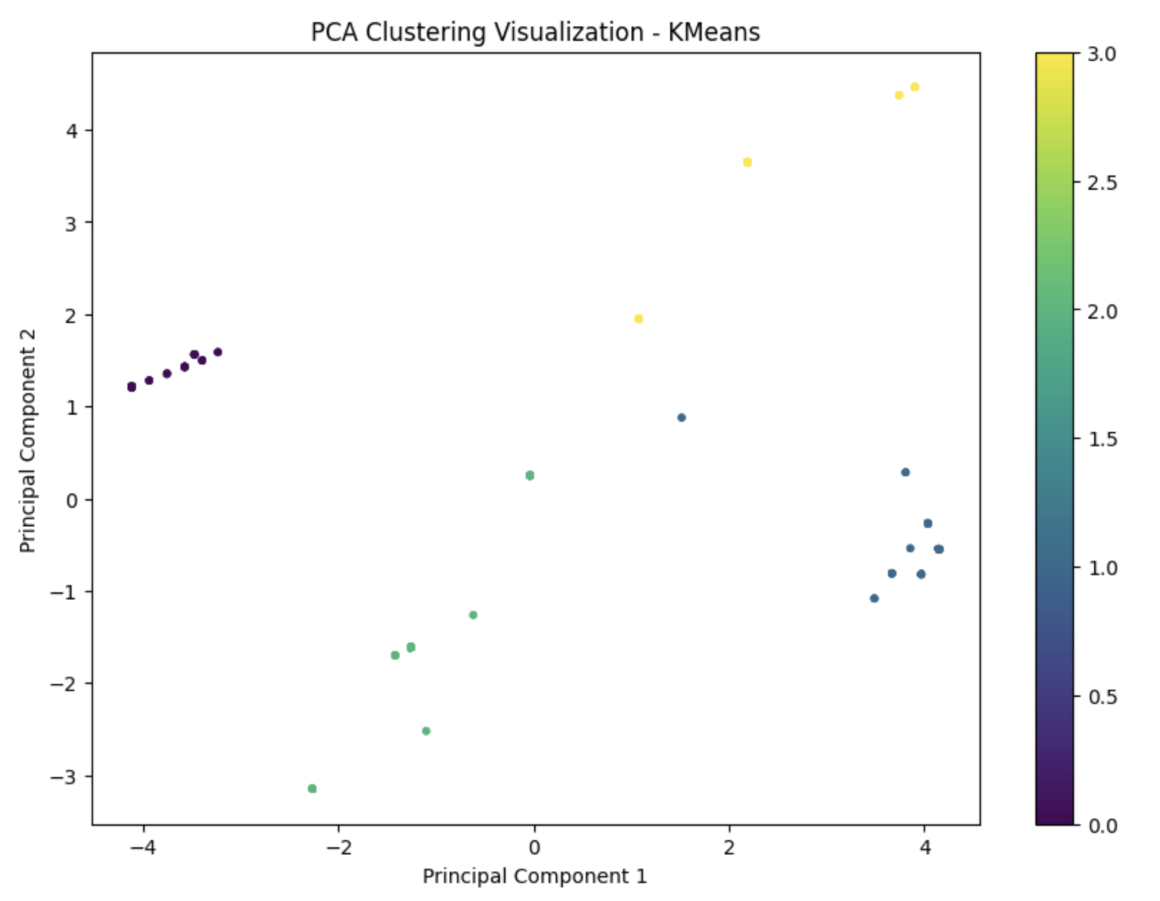
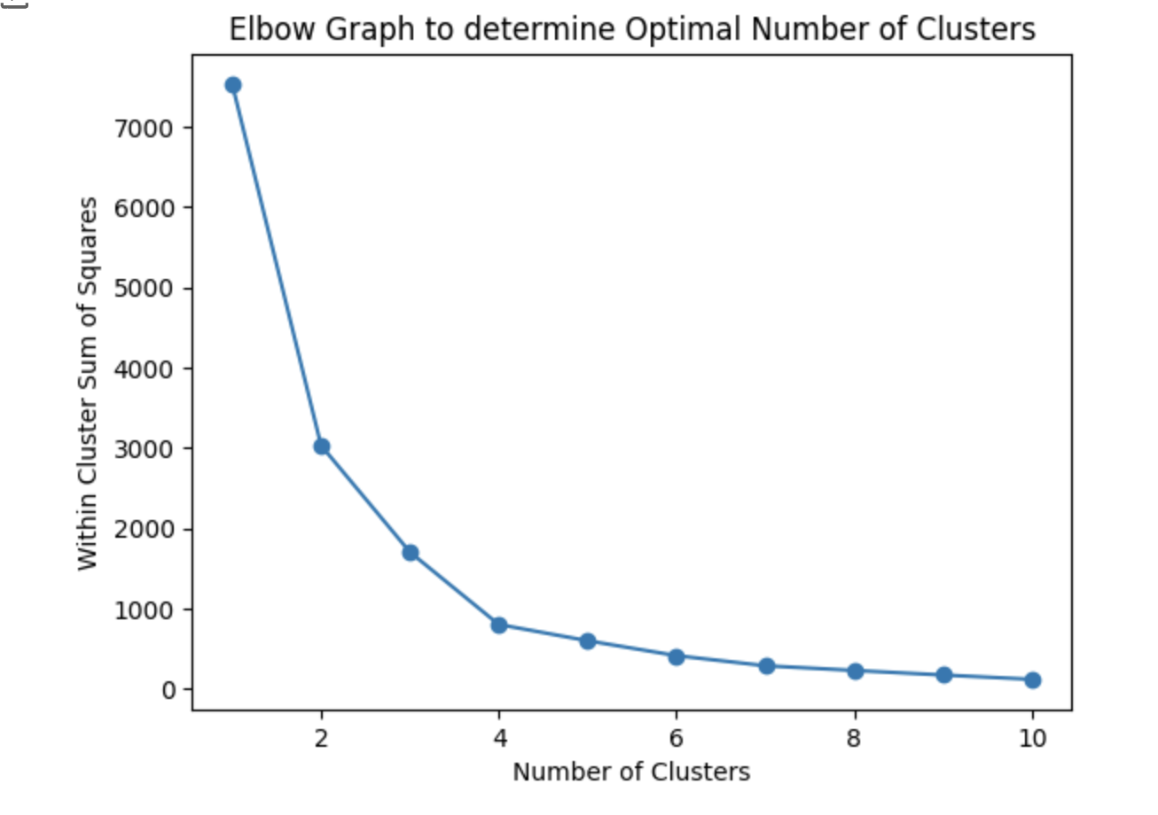
Unsupervised Learning Models K-Means Clustering vs Hierarchical Clustering
Optimal Number of Clusters = 4
Silhouette Score: 0.75

Slide 9
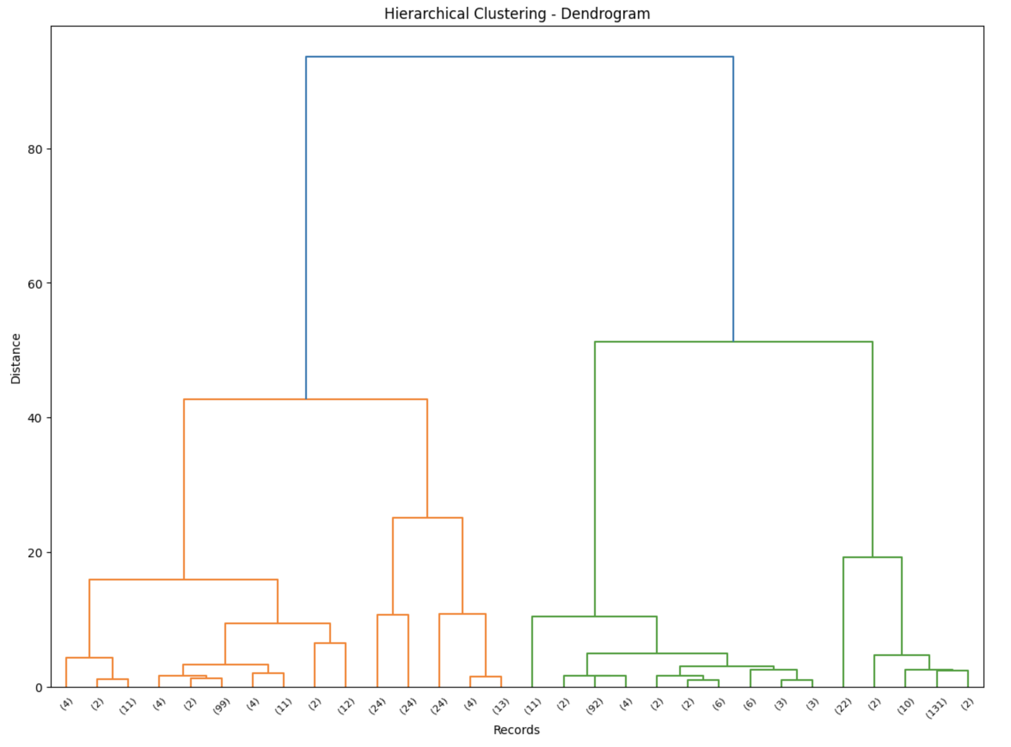
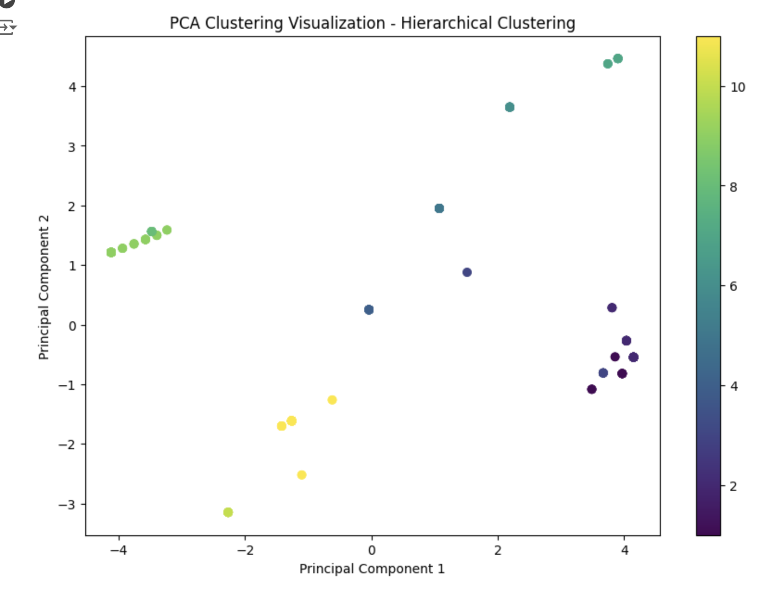
Unsupervised Learning Models K-Means Clustering vs Hierarchical Clustering
Silhouette Score: 0.90
Unsupervised Learning Models performed better on this dataset compared to the Supervised Learning Models

Slide 10
Limitations & Future Scope
Limitations:
Small size of the dataset
Results highly dependent on data and cannot be extrapolated to all kinds of datasets
Future Scope:
Study other machine learning algorithms and evaluate performance
Try different algorithms with a larger dataset

Slide 11
Thanks!
Do you have any questions?

